Slide 1
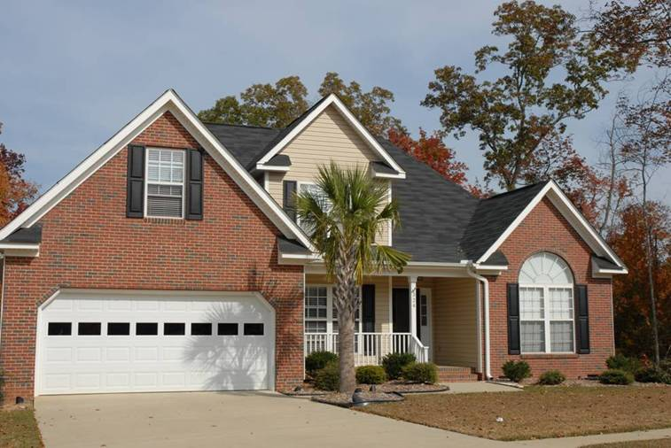
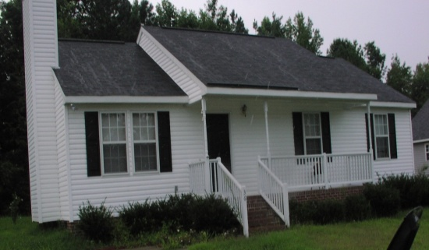
Single Family Housing Programs
Investing in Rural Communities

Slide 2
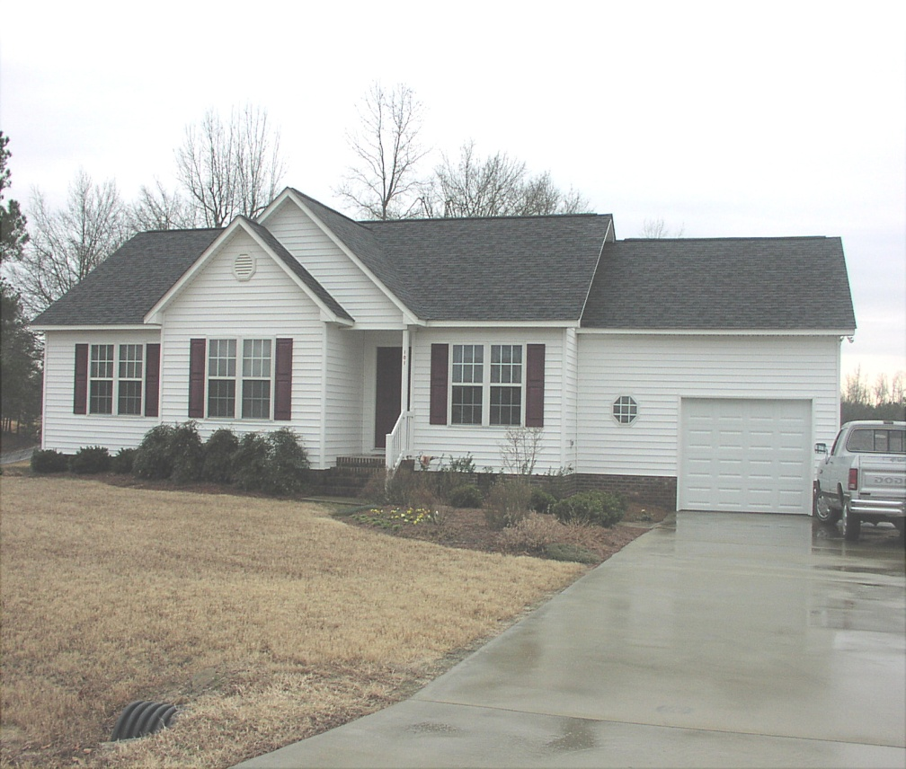
Provide people in rural communities the opportunity to
own adequate, modest, decent, safe, & sanitary homes
Purpose
In addition to providing loan funds for a house purchase, this program can help very low and low-income rural homeowners make vital improvements to their homes.
Loan funds are available to make substantial home repairs when other loan options are not available.

Slide 3
Single Family Housing Programs
Section 502 Guaranteed Loans
Section 502 Direct Loans
Section 504 Repair Loans
Section 504 Repair Grants
Mutual Self Help Housing
Housing Preservation Grants
Rural Housing Site Loans

Slide 4
Area and Sub-Offices

Slide 5
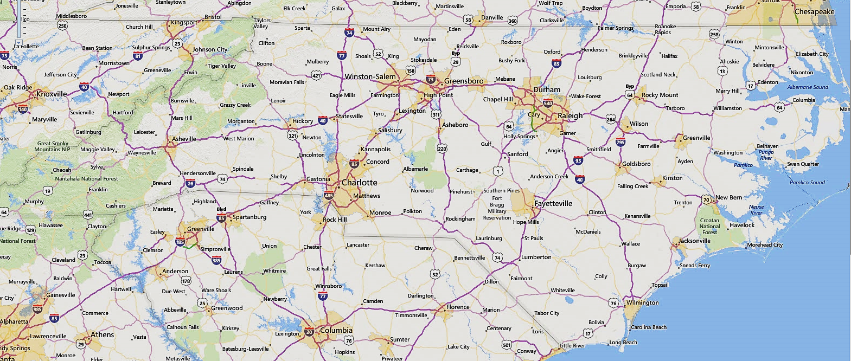
Section 504 Repair Loans and Grants
What is an eligible area?

Slide 6
Section 504 Repair Loans and Grants
What does this program do?
Also known as the Section 504 Home Repair program
Provides loans to very-low-income homeowners to repair, improve or modernize their homes
Grants to elderly very-low-income homeowners to remove health and safety hazards.

Slide 7
Section 504 Repair Loans and Grants
Who may apply for this program?
To qualify, you must:
Be the homeowner and occupy the house
Be unable to obtain affordable credit elsewhere
Have a family income below 50 percent of the area median income
For grants, be age 62 or older and not be able to repay a repair loan

Slide 8
Section 504 Repair Loans and Grants
How may funds be used?
Loans may be used to repair, improve or modernize homes or remove health and safety hazards
Grants must be used to remove health and safety hazards
How much money can I get?
Maximum loan is $20,000
Maximum grant is $7,500
Loans and grants can be combined for up to $27,500 in assistance

Slide 9
Section 504 Repair Loans and Grants
What are the terms of the loan or grant?
Loans can be repaid over 20 years
Loan interest rate is fixed at 1%
Full title service is required for loans of $7,500 or more
Grants have a lifetime limit of $7,500
Grants must be repaid if the property is sold in less than 3 years
If applicants can repay part, but not all of the costs, applicants may be offered a loan and grant combination

Slide 10
Ownership of Property:
Section 504 loan/grant applicants may demonstrate ownership by presenting any of the following:
Records of the local taxing authority that show the applicant as owner and that demonstrate that real estate taxes for the property are paid by the applicant;
Affidavits by others in the community stating that the applicant has occupied the property as the apparent owner for a period of at least 10 years, and is generally believed to be the owner; or

Slide 11
Section 504 Repair Loans and Grants
Restrictions on the Use of 504 Funds:
Assist in the construction of a new dwelling;
Make repairs to a dwelling in such poor condition that when the repairs are completed, the dwelling will continue to have major hazards;
Move a mobile home or manufactured home from one site to another;
Pay for any off-site improvements except for necessary installation and assessment costs for utilities;
Refinance any debt or obligation that the applicant incurred before the date of application (except for payment of the installation and assessment costs of utilities);
Purchase or install equipment in the property (e.g., ranges, refrigerators, washers or dryers);
Pay packaging fees to for-profit entities;
Provide site preparation (e.g., grading, foundation plantings, seeding or sodding,trees, walks, yard fences, or driveways to a building site);
Construction of new decks (existing decks may be repaired if a safety hazard exists);
Installation of concrete or asphalt driveways; or

Slide 12
Water and Waste Water Systems

Slide 13
Water and Waste Water Systems

Slide 14
Water and Waste Water Systems

Slide 15
Water and Waste Water Systems

Slide 16
Water and Waste Water Systems

Slide 17
www.rd.usda.gov/nc

Slide 18
Single Family Housing Programs
William Kenney
Single Family Housing
Program Director
919-873-2051
william.kenney@nc.usda.gov
Website: www.rd.usda.gov/nc

